Slide 1
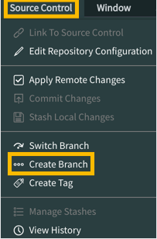
Exercise: Create a Branch for the Client-side Scripting Module
In this exercise, you will create a branch of the NeedIt application for the Client-side Scripting module that includes the application files used in the module.
If the NeedIt application is not open in Studio from the previous exercise, open it now.
In the main ServiceNow browser window, use the All menu to open System Applications > Studio.
In the Select Application dialog, click the NeedIt application.
In Studio, open the Source Control menu and select the Create Branch menu item.
Configure the branch.
Branch Name: ClientScriptsModule
Create from Tag: LoadForClientScriptsModule
Click the Create Branch button.
Click the Close button.
To load the application files included in the tag, return to the main ServiceNow browser tab (not Studio) and click the browser's reload button to refresh the page.

Slide 2
Exercise: Test Client Script Types
In this exercise you will test the onLoad, onChange, and onSubmit Client Script types using pre-built Client Scripts from the GitHub repository you forked.
Preparation
1. If the NeedIt application is not open in Studio from the last exercise, open it now.
a. In the main ServiceNow browser window, open the All menu.
b. In the Filter field, enter Studio.
c. Open System Applications > Studio.
d. In the Select Application dialog, click the NeedIt application.
2. Make the NeedIt onLoad Example Client Script active.
a. In Studio, use the Application Explorer to open Client Development > Client Scripts > NeedIt onLoad Example.
b. Select the Active option.

Slide 3
Exercise: Test Client Script Types
c. Examine the configuration to see which table the script is for.
3. Examine the Script field to determine what the script does.
4. Click the Update button.
5. Using the same strategy, make the NeedIt onSubmit Example and the NeedIt
onChange Example Client Scripts active. For the onChange Client Script, make
a note of the value in the Field name field.

Slide 4
Exercise: Testing the Client Script Types
Testing the Client Scripts
1. In the main ServiceNow browser window (not Studio) use the All menu to open NeedIt > All.
2. Test the NeedIt onChange Example Client Script.
Open the NeedIt record of your choice for editing.
Does an alert appear? If not, make sure you made the NeedIt onLoad Example Client Script active and saved the change.
With the alert still open, try to modify a field value on the form. You should not be able to modify the form until the NeedIt onLoad Example script finishes execution. onLoad Client scripts with alerts prevent control of the form from being given to the user until the alert is closed.
Click the OK button to close the alert.

Slide 5
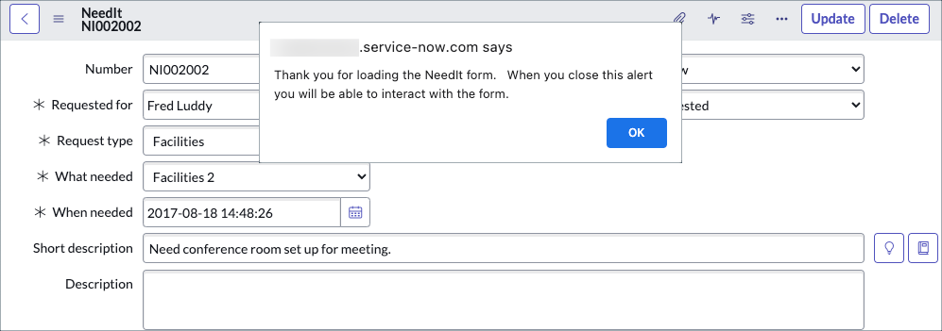
Exercise: Testing the Client Script Types

Slide 6
Exercise: Testing the Client Scripts
3. Test the NeedIt onChange Example Client Script.
a. Edit any field on the form except the Short description field.
b. No alert should appear.
c. Edit the value in the Short description field then click on the form outside of the field.
d. An alert should appear showing the oldValue and the newValue. If no alert appears, make sure you made the NeedIt onChange Example Client Script active and saved the change.
e. Click the OK button to close the alert.
f. Edit the Short description field again then click outside of the field.
g. In the alert, notice that oldValue has not changed.
h. Click the OK button to close the alert.

Slide 7
Exercise: Testing the Client Scripts
4. Test the NeedIt onSubmit Example Client Script.
a. Click the Update button on the form header.
b. Does the alert appear? If not, make sure you made the NeedIt onSubmit Example Client Script active and saved the change.
c. Click the OK button to close the alert.
5. Return to Studio and make the Client Scripts inactive:
NeedIt onLoad Example
NeedIt onChange Example
NeedIt onSubmit Example
Notes:
15

